Slide 1

DEPARTMENT OF COMPUTER SCIENCE AND ENGINEERING
Professional Training – 1
Predicting Heart Disease using Machine Learning
PROJECT STUDENT
Sanaka Leela Sukanya REG NO : 42111597
GUIDE
Dr.P.Ajitha,M.E.,Ph.D.,
Associate Professor,CSE

Slide 2
Presentation Outline
Certification
Introduction
Abstract
Existing Availabilities
Disadvantage of existing Product
Proposed Product
Advantage of proposed Product
Design requirements
Design Diagram
Product Working Principle
Reference

Slide 3

CERTIFICATION

Slide 4
Introduction
Machine Learning is a very vast and diverse field and its scope and implementation is increasing day by day. Machine learning Incorporates various classifiers of Supervised, Unsupervised and Ensemble Learning which are used to predict and Find the Accuracy of the given dataset.
The objective of this project is to check difficult to identify heart disease because of several contributory risk factors such as diabetes, high blood pressure, high cholesterol, abnormal pulse rate and many other factors.
Various techniques in data mining and neural networks have been employed to find out the severity of heart disease among humans. The severity of the disease is classified based on various methods like K-Nearest Neighbor Algorithm (KNN), Decision Trees (DT), Logistic Regression (LR), and Support Vector Machine (SVM).

Slide 5
Abstract
Heart Attack is a term that assigns a large number of medical conditions related to heart. The key to Heart (Cardiovascular) diseases to evaluate large scores of data sets, compare information that can be used to predict, Prevent, Manage such as Heart attacks.
Heart Disease is mainly because of stress, family backgrounds, High blood Pressure, etc… Data Science is used to incorporate world for its valuable use to controlling, contrasting and manage a large data set. It can be applied with an much success to predict, prevent, Managing a cardiovascular disease.
To solve this, we aim to implement the Data Science based on SVM and Genetic Algorithm to diagnosis of heart diseases. This result reveals the Genetic Algorithm as best optimized Prediction Models.

Slide 6
Existing Availabilities
Product Availabilities:
Traditionally, heart disease prediction has relied on rule-based models or standard statistical methods like logistic regression. These systems typically analyze clinical parameters such as age, blood pressure, cholesterol levels, and family history to estimate a patient's risk of heart disease.
Key Aspects of Existing System:
Data sources: The data primarily come from patient records etc….
Algorithms used: Existing systems may use basic statistical techniques such as:
Logistic regression
Decision trees
Naive Bayes
Support Vector Machines (SVM)

Slide 7
Disadvantages
Accuracy: The existing rule-based or simple models may not generalize well to different populations.
Feature selection: Important features could be overlooked, and non-linear relationships between factors may not be captured.
Scalability: Existing systems may not efficiently handle large datasets or real-time predictions.
Lack of personalization: Predictions are usually generalized and do not tailor well to individual patients.

Slide 8
Proposed Product
The proposed system aims to improve heart disease prediction by leveraging more advanced machine learning techniques, such as deep learning, and incorporating modern data science practices. Additionally, the system could integrate various data types, such as genomic data, wearable data, and EHR (Electronic Health Record) data, to enhance prediction accuracy and patient personalization.
Key Features of the Proposed System:
Data Integration Advanced Machine Learning Algorithms
Random Forests or Gradient Boosting
Deep Learning
Ensemble Learning
Personalized Predictions
Explainability and Interpretability
Real-time Monitoring

Slide 9
Advantages of the proposed product
Improved Accuracy: By integrating various types of data (clinical, genomic, wearable) and using more powerful algorithms, the system can provide better predictions.
Personalization: Tailors the risk prediction model based on individual data.
Proactive Care: Real-time data can allow for early detection and proactive interventions, potentially saving lives.
Interpretability: Models such as SHAP or LIME can help doctors understand the rationale behind predictions, ensuring trust in the system.

Slide 10
Product Features
• Utility: It refers to the usefulness and value of the product in solving a specific problem—in this case, predicting heart disease.
• Usability: It refers to how easy and intuitive the product is for users to operate.
Performance : It refers to the effectiveness and efficiency of
the product, particularly in terms of its predictive accuracy and speed.

Slide 11
Design Requirements
Hardware requirements:
Processor | Intel (R) Core (TM) i3
Processor Speed | 3.06GHz
Ram | 2GB
Hard Disk Drive | 250GB
Floppy Disk Drive | Sony
CD-ROM | Sony
Monitor | “17” Inches
Keyboard | TVS Gold

Slide 12
Software requirements
Server
Operating System | Windows 7
Technology Used | Python
Database | My-sql
Database Connectivity | Native Connectivity
Web Server | Apache
Browser | Internet Explorer 6.0
Client
Operating System | Windows 7
Browser | Internet Explorer 6.0

Slide 13
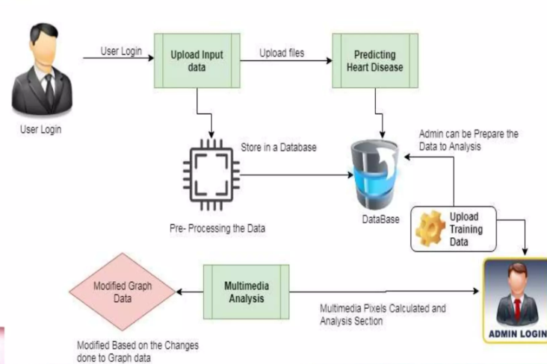
Working Principles Design diagram

Slide 14
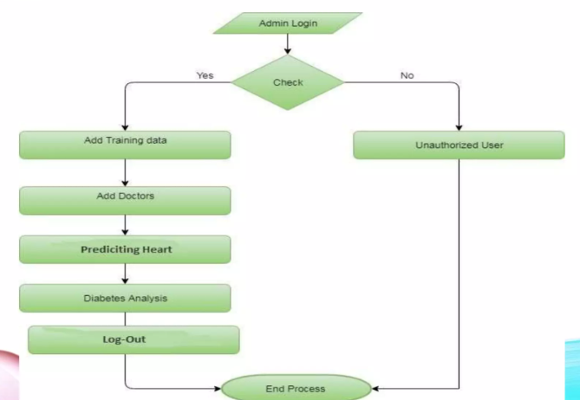
Admin

Slide 15
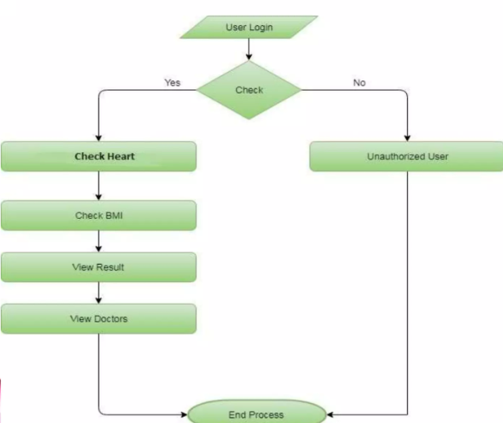
User

Slide 16

Home Page

Slide 17
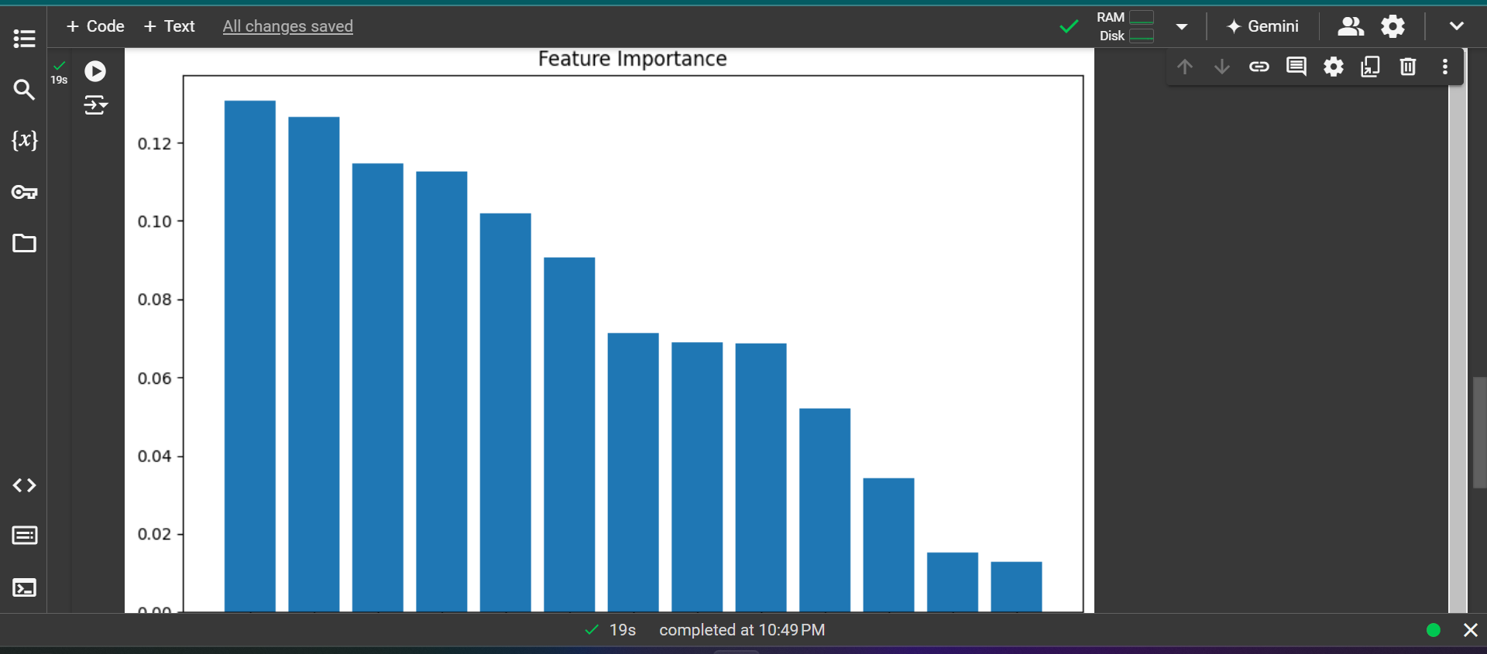
Cond..

Slide 18
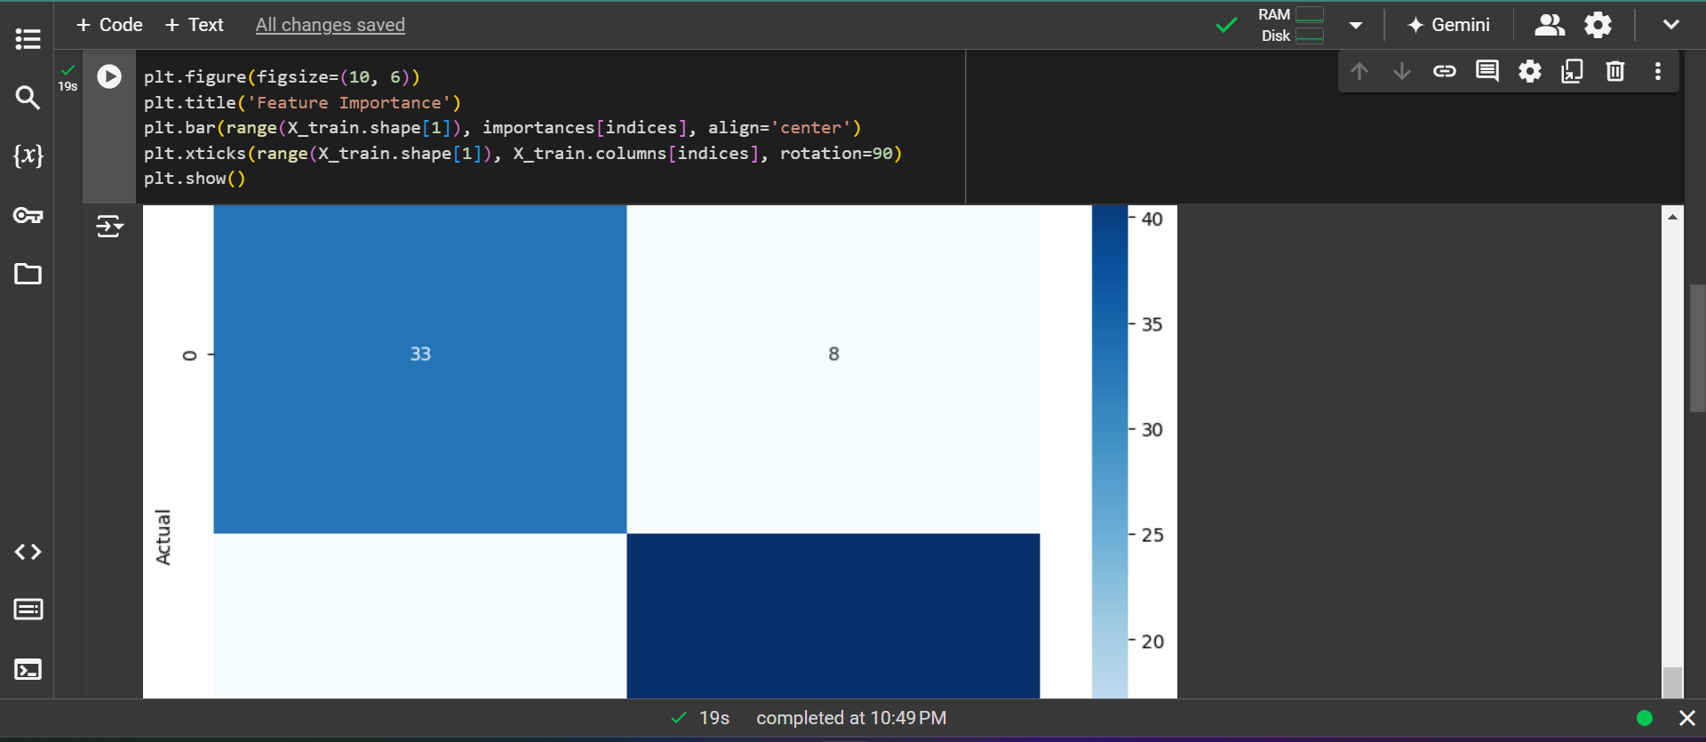
Graphs

Slide 19
Future Enhancement
In future we can be made to produce an impact in the accuracy of the Decision Tree and Bayesian Classification for additional improvement after applying genetic.
Algorithm in order to decrease the actual data for acquiring the optimal subset of attribute that is enough for heart disease prediction. The automation of heart disease prediction using actual real time data from health care organizations and agencies which can be built using big data.
They can be fed as a streaming data and By using the data, investigation of the patients in real time can be prepared.

Slide 20
Conclusion
Identifying the processing of raw healthcare data of heart information will help in the long-term saving of human lives and early detection of abnormalities in heart conditions.
Machine learning techniques were used in this work to process raw data and provide a new and novel discernment towards heart disease. Heart disease prediction is challenging and very important in the medical.
However, the mortality rate can be drastically controlled if the disease is detected at the early stages and preventative measures are adopted as soon as possible. Further extension of this study is highly desirable to direct the investigations to real-world datasets instead of just theoretical approaches and simulations.
The proposed hybrid HRFLM approach is used combining the characteristics of Random Forest (RF) and Linear Method (LM). HRFLM proved to be quite accurate in the prediction of heart disease.
The future course of this research can be performed with diverse mixtures of machine learning techniques to better prediction techniques. Furthermore, new feature selection methods can be developed to get a broader perception of the significant features to increase the performance of heart disease prediction

Slide 21
Reference
Latha Parthiban and R. Subramanian, “Intelligent Heart Disease Prediction System using CANFIS and Genetic Algorithm”, International Journal of Biological, Biomedical and Medical Sciences, Vol. 3, No. 3, pp. 1-8, 2008.
Latha Parthiban and R. Subramanian, “Intelligent Heart Disease Prediction System using CANFIS and Genetic Algorithm”, International Journal of Biological, Biomedical and Medical Sciences, Vol. 3, No. 3, pp. 1-8, 2008.
Sellappan Palaniappan and Rafiah Awang, “Intelligent Heart Disease Prediction System using Data Mining Techniques”, International Journal of Computer Science and Network Security, Vol. 8, No. 8, pp. 1-6, 2008

Slide 22

THANK YOU
We thank God,Our Department,Guide,Panel Members,Supportive Professors and all Technical and non Technical staff who helped us in our project

